Slide 1
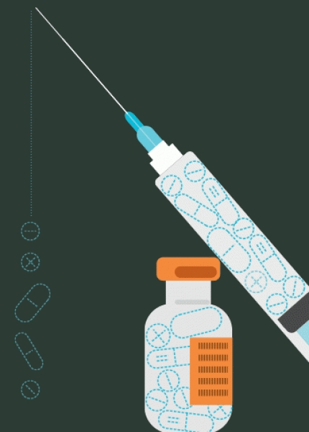
Ocular therapeutics
💫ROute of administration
P.Ajay Deepak 17 – III – MBBS
Guided by – Dr.Radhika

Slide 2
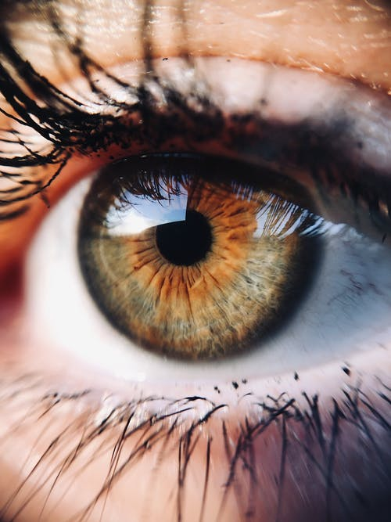
Route of administration
By four methods
Topical instillation
Periocular injection
Intraocular injection
Systemic administration

Slide 3
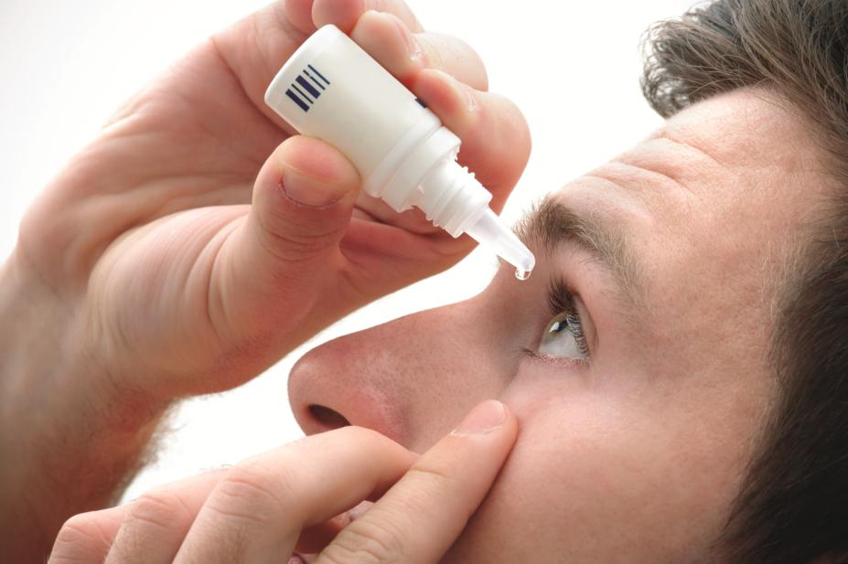
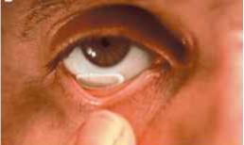
I) Topical instillation
Most common route
Topical forms –
Eye drops
Ointments
Gels
Ocuserts
Soft contact lenses

Slide 4
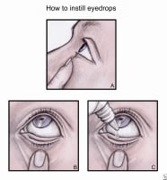
Eye drops
Simplest & convenient method
Especially for daytime use
In the form of
Aqueous solution
Aqueous suspension
Oily solution
Drug action – Immediate action
Quickly diluted by tears ( within a minute )

Slide 5
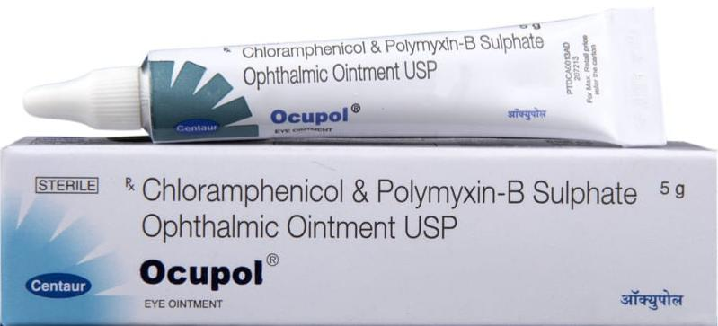
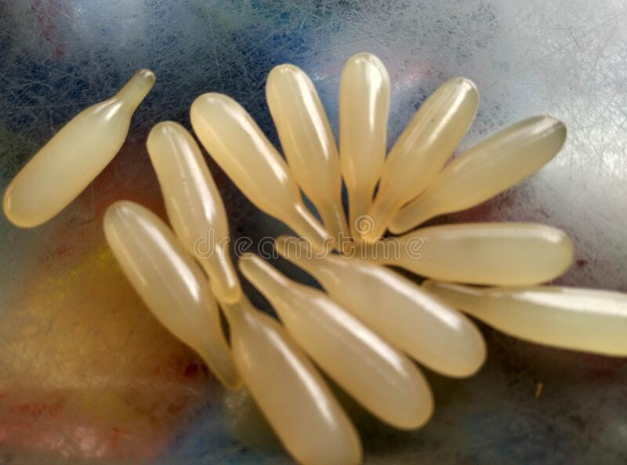
Eye ointment
It increases bioavailability by
Increase tissue contact time
Preventing dilution
Quick absorption
Not for immediate use
Blur the vision
Best at bedtime application

Slide 6
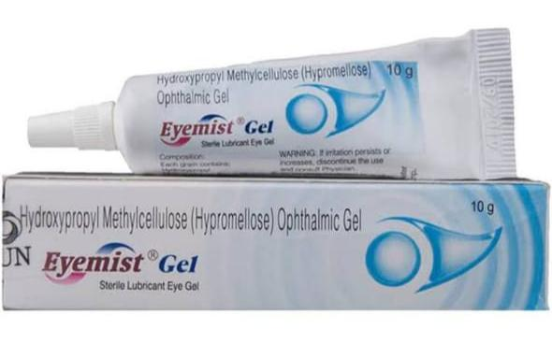
Gels
Has long contact time
Don’t cause much blurring of vision
Costly
Difficult to prepare

Slide 7
Ocuserts
Drug delivery through a memberane
Placed in upper/lower fornix
Drug released upto a week
In constant rate
Pilocarpine ocuserts – Poag – controls IOP with fewer side effects

Slide 9
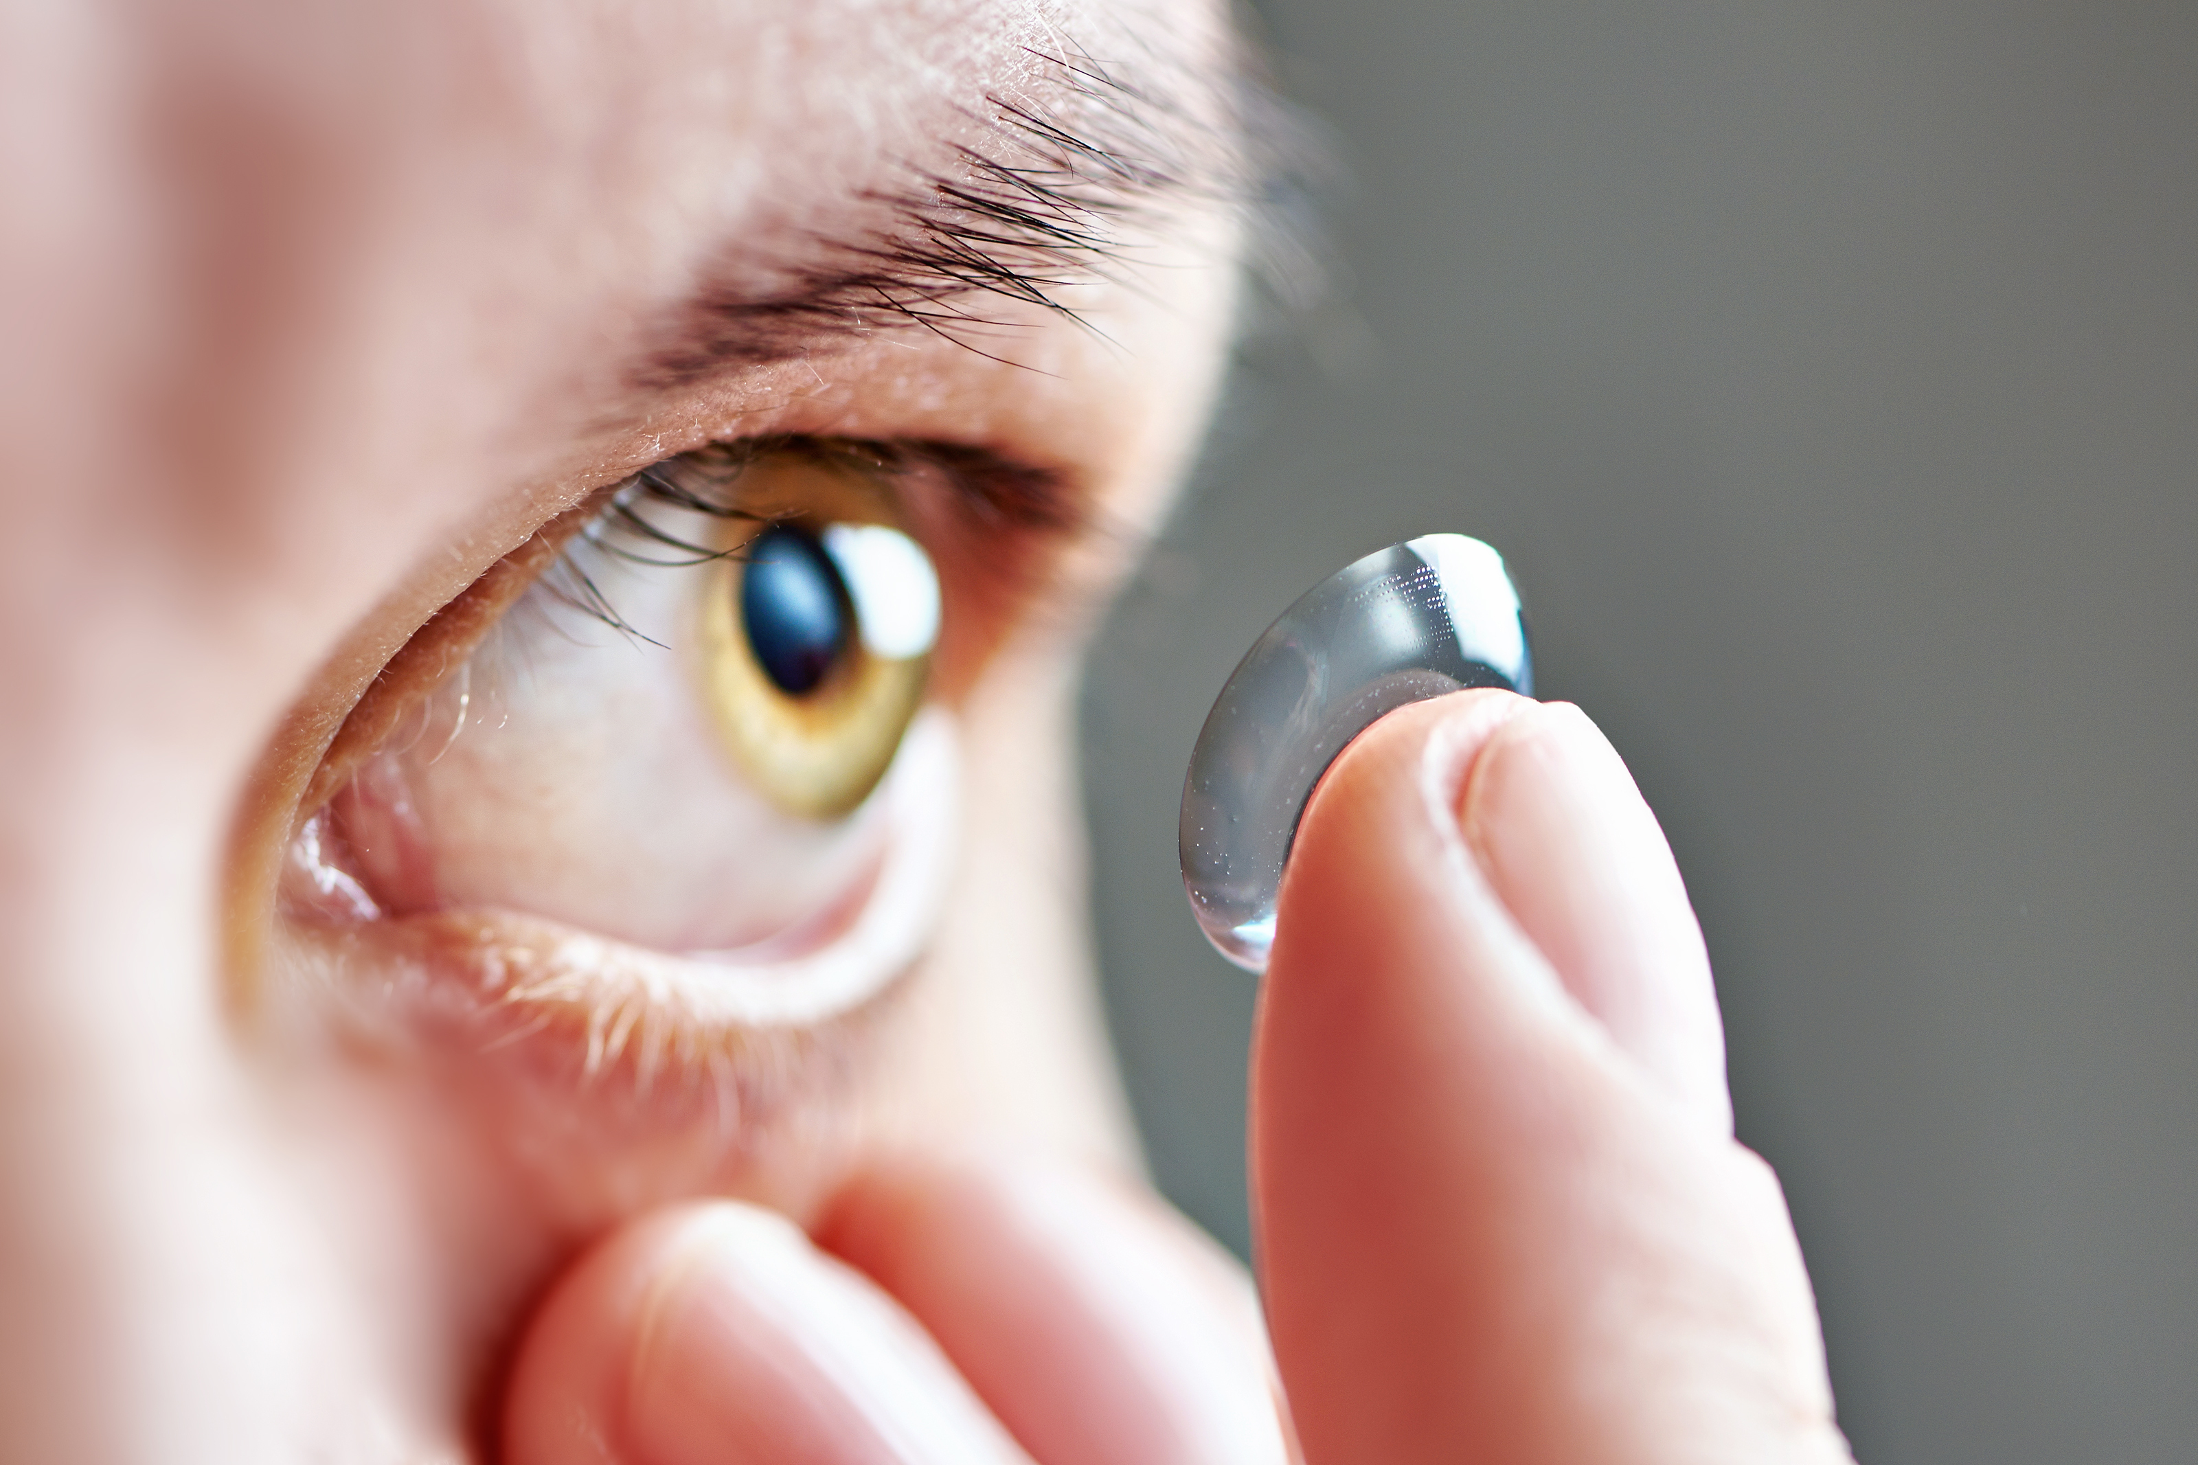
Soft contact lenses
For higher conc. Drug delivering – emergency treatment
Pre-soaked in 1% pilocarpine=4% pilocarpine eye drops in acute angle closure glaucoma
It is also used to deliver antibiotics & antiviral drugs – in corneal ulcer

Slide 10
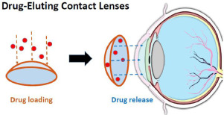

Slide 11
Intraocular penetration of topically instilled drugs
Through cornea – large penEtration
Main Barriers
Epithelium – lipophilic – crossed readily by non polar drugs
Stroma – hydrophilic – endothelium

Slide 12
Features For better penetration of drugs through cornea
Soluble both in water and fats
Prodrug - lipophilic
Converted into proper drug
Agents that reduce surface tention Increase Corneal wetting and therefore present more drug For absorption
Benzalkonium chloride (PreservatiVe) also act as wetting agent – increase drug absorption

Slide 13
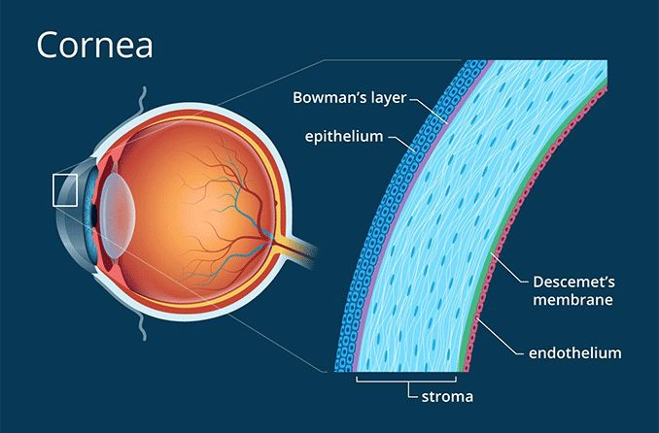
Rate and extent of ocular absorption
The most important of these are
Precorneal factor – tear volume (7-30 Micro l )
Tear turnover time (0.5-2.2 micro L /min )
Spontaneous blink rate (15 times/min )
Corneal thickness
Conjunctival : Corneal surface area ( 17:1 )
-also influence ocular absorption

Slide 14
Cont:
All of these combine to limit the time
Drug remains in the conjunctival sac to 3-5 mins on average
This time will reduce further if the medication is irritative,causing increased tear production & blinking

Slide 15
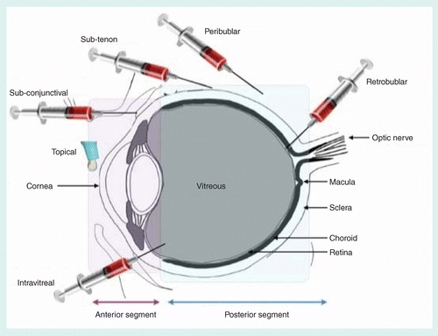
II) Periocular injection
These includes
Subconjunctival
Subtenon
Retrobulbar
Peribulbar
Not frequently employed

Slide 16
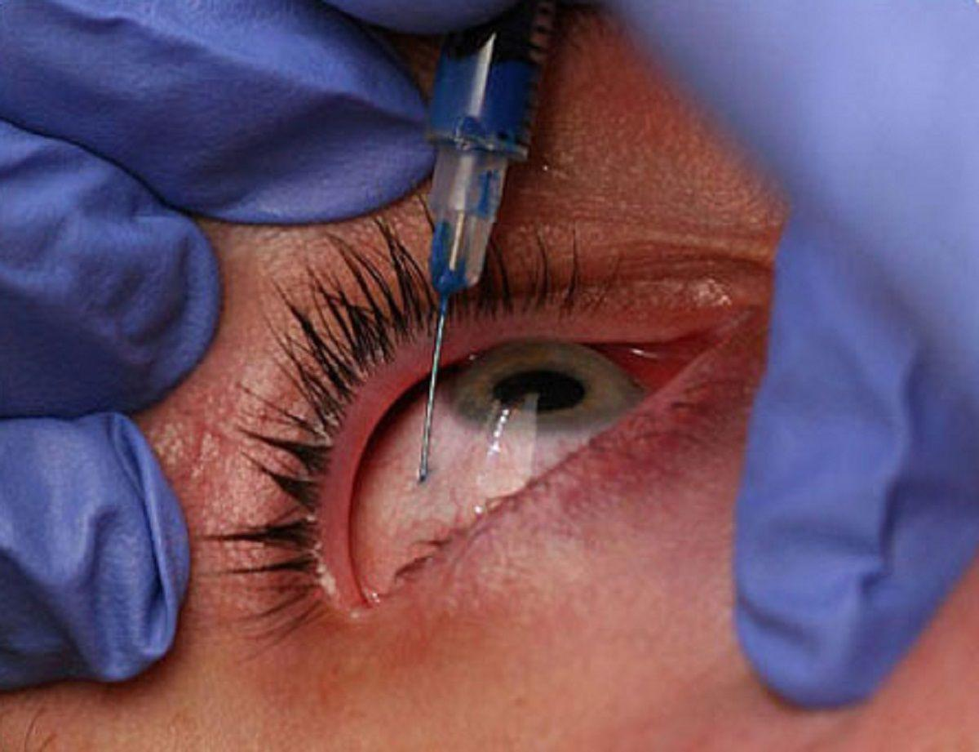
Subconjunctival injection
Used to achieve higher conc of drugs
the drug which can’t pass through cornea
owing to large sized molecules can
easily pass through sclera

Slide 17
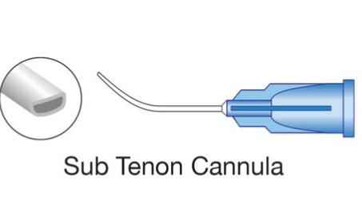
Subtenon injection
Preferred over subconjunctival inj
Anterior sub-tenon inj.
to administer steroids in The treatment of severe or resistant uveitis
Posterior sub-tenon inj.
Indicated in patients with intermediate and posterior uveitis

Slide 18
Retrobulbar injection
For optic neuritis , papillitis, posterior uveitis
administering retrobulbar block anasthesia
Peribulbar injection
For injecting anasthetic agents
replace the retrobulbar injection
& facial block anaesthesia

Slide 19
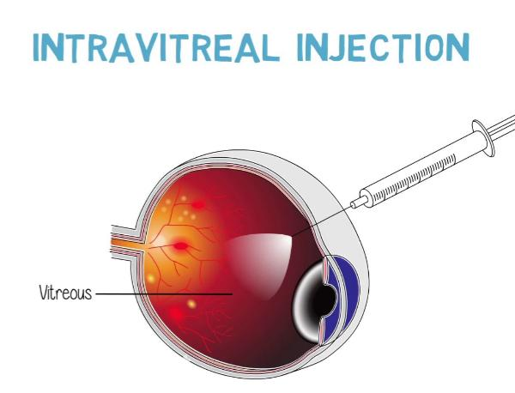
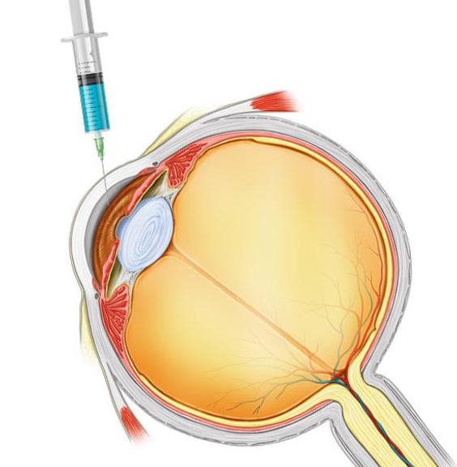
III) INTRAOCULAR INJECTION AND IMPLANTS
To deliver drug in max conc. At the target tissue
Intraocular injection include
- intracamEral injection - into anterior chamber
- intravitreal injection – into vitreous cavity
Intravitreal drug implants – inserts into vitreous cavity through pars plana for sustained slow release
Example
- steroids implants of flucinolone and dexamethasone – posterior uveitis & diabetic macular oedema
-ganciclovir implants for Cytomegalovirus retinitis

Slide 20
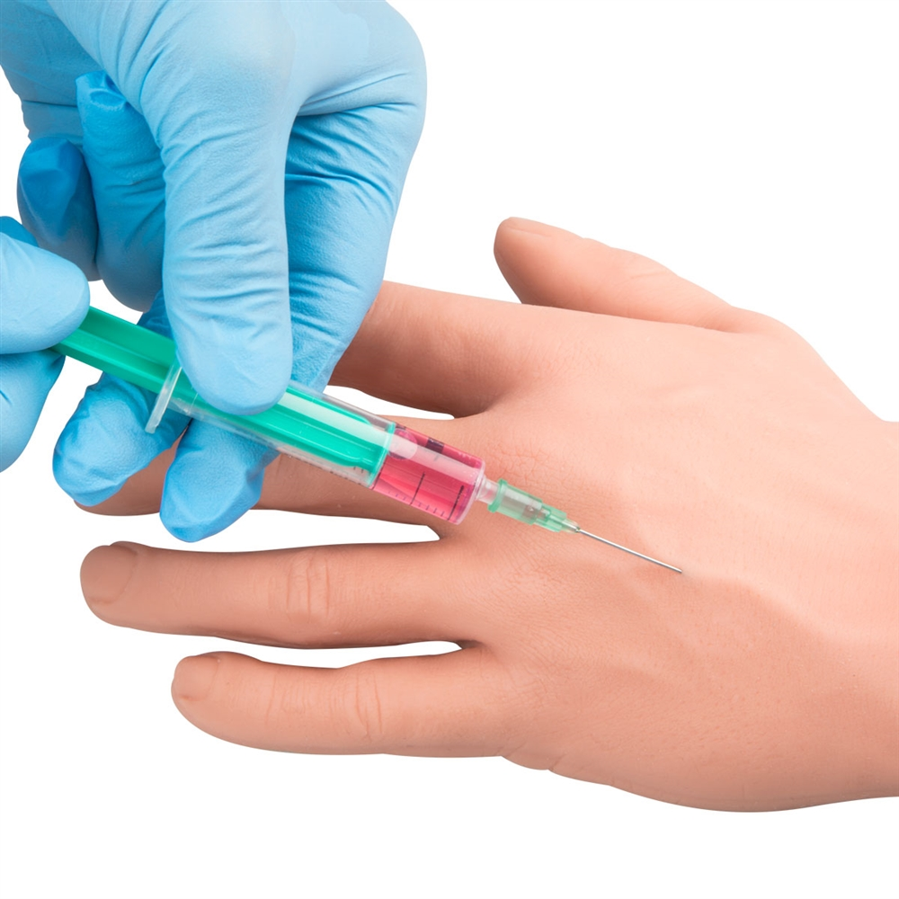
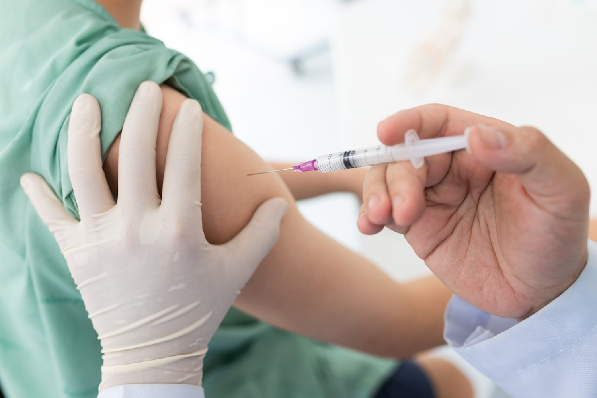
IV) Systemic administration
Oral intake
Intramuscular inj.
Intravenous Inj.

Slide 21
Systemic administration
depends upon blood-aqueous Barrier
influenced by molecular weight & lipid solubility
Only low molecular weight drugs can cross this blood – aqueous barrier
No passage is allowed to large-Sized molecules such as penicillin
High lipid solubility can pass easily
ex- Sulphonamides 16 times more PermeabilE
Chloramphenical – enters eye Easily

Slide 22
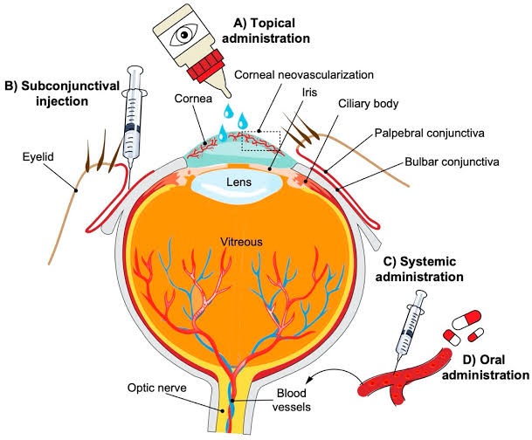

Slide 23
கடினம்
கடினமான வாழ்கை பாதை
பயணம் செய்ய நாளும் விரும்பு
விரும்பிய செயல்கள் விண் நோக்கி செலுத்தும்
பாதை கடினம் பதராய் நீங்கும்
யாவும் இங்கே கடினம் தான்
கடந்து போகும் வரையில் தான்
மலையைக் கண்டு மலைத்து விடாதே
மரணம் வரையில் முயற்சி நிறுத்தி விடாதே
- அஜய்

